Slide 1
LA Traffic Collision Inspector
Tao Xu, Xirui Zhong
Group 8

Slide 2
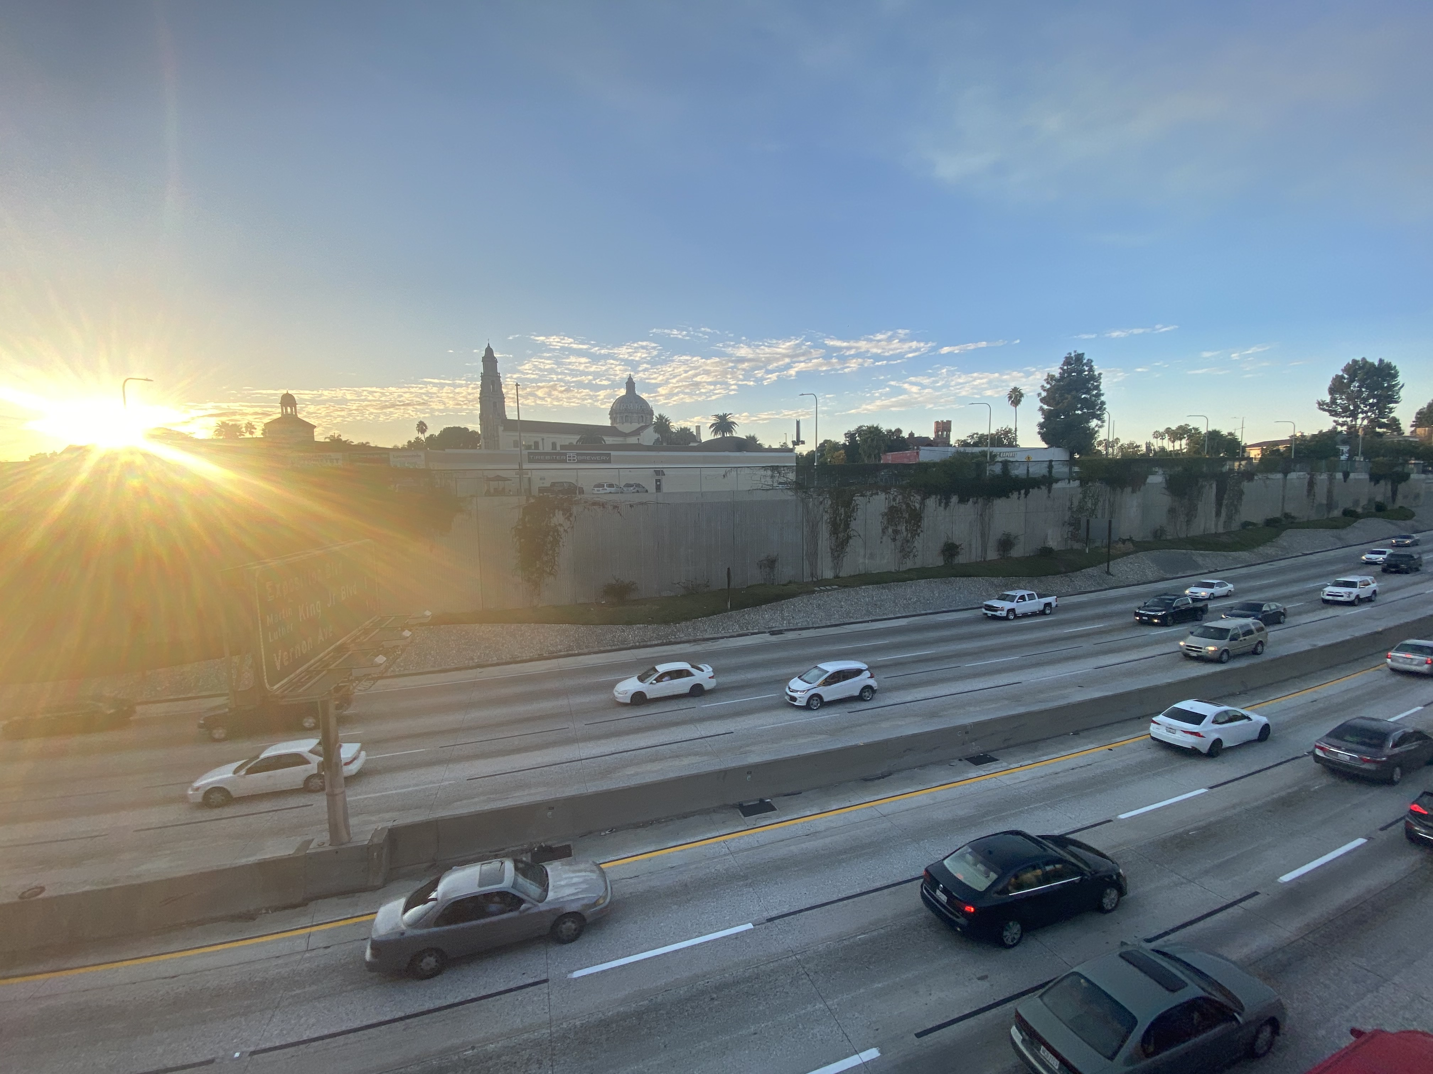
Topic
We designed a web app that has similar function compare to Kaggle open dataset website. This web app can display LA traffic collision data from cloud data storage. The customers are able to use searching, sorting and filtering function to retrieve data they are interested. Moreover, they can use data visualization charts provided from website to see how data is distributed.

Slide 3
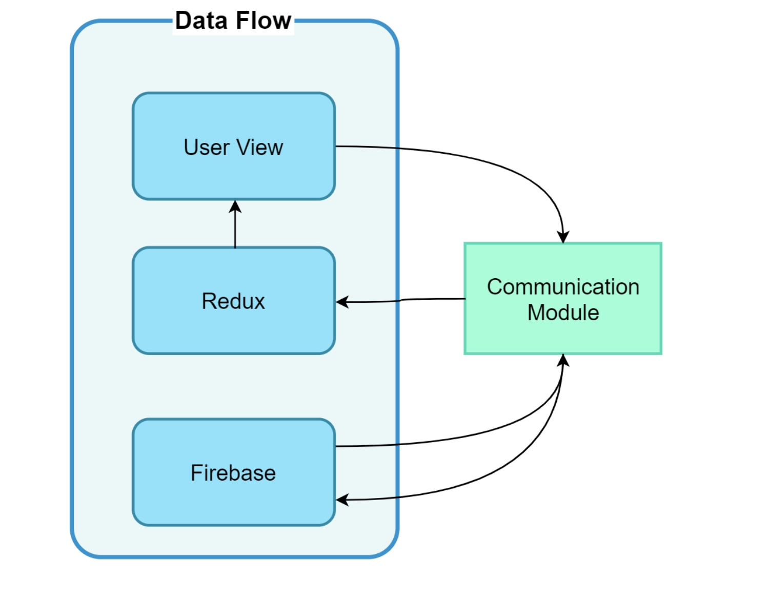
Things we did
Transferred csv data from Kaggle to json with python and uploaded to Firestore.
Built a web app based on ReactJS Framework.
Designed web UI , sorting, searching, and filtering functions with Ant-Design API.
Created a middle tire server with nodeJS to request data from Firestore.
Wrote Redux function as data manipulation tools.

Slide 4
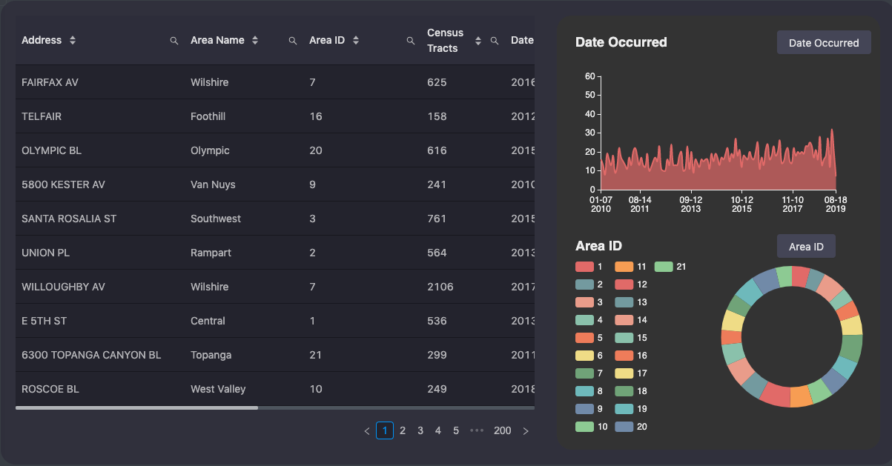
Demo

Slide 5
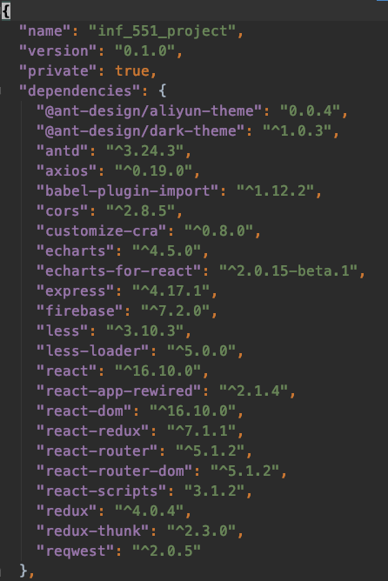
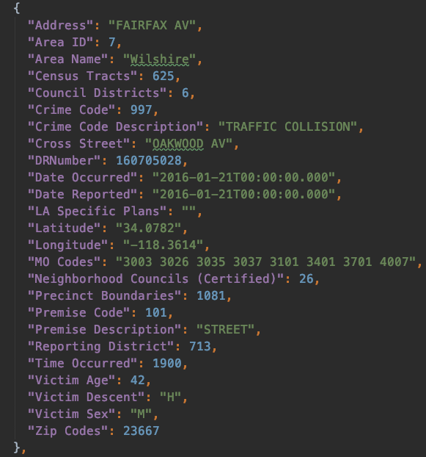
Project framework
package.json
Json sample dataset

Slide 6
Code Explanations…

